Slide 1



Slide 2
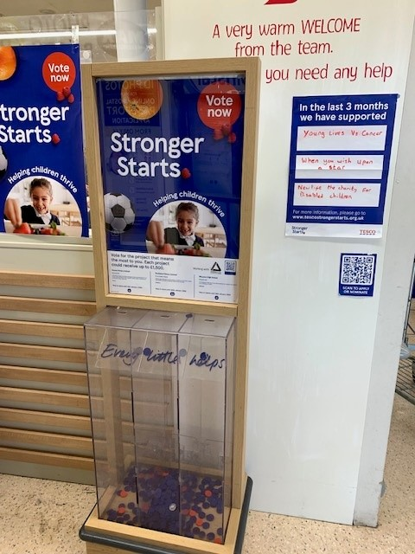
Applications submitted by 5th August will be considered for
the Oct – Dec customer vote with awards in Feb ‘25
Follow the slides to find out:
who can apply
how it works
who can help you
what kind of projects are eligible
where to apply
examples of what has been funded previously

Slide 3

Local Rainbow, Brownie, Guide and Ranger groups with a constitution and treasurer’s bank account can apply
Regional offices, the Outdoor or Learning and Development Teams can apply on behalf of a local group for local activities
3 projects go to vote in each of the 87 regional award areas every 3 months in Scotland
Up to £261,000 is awarded to 261 projects in Scotland every 3 months
Who Can Apply and
How does it work?
Notes:
Very small and / or new local organisations can apply as long as they have a constitution and a treasurers / community bank account.
Often small organisations, without the above, can apply through a larger local organisation such as a development trust, community council or even through their school ie. parent councils without their own bank account.

Slide 4
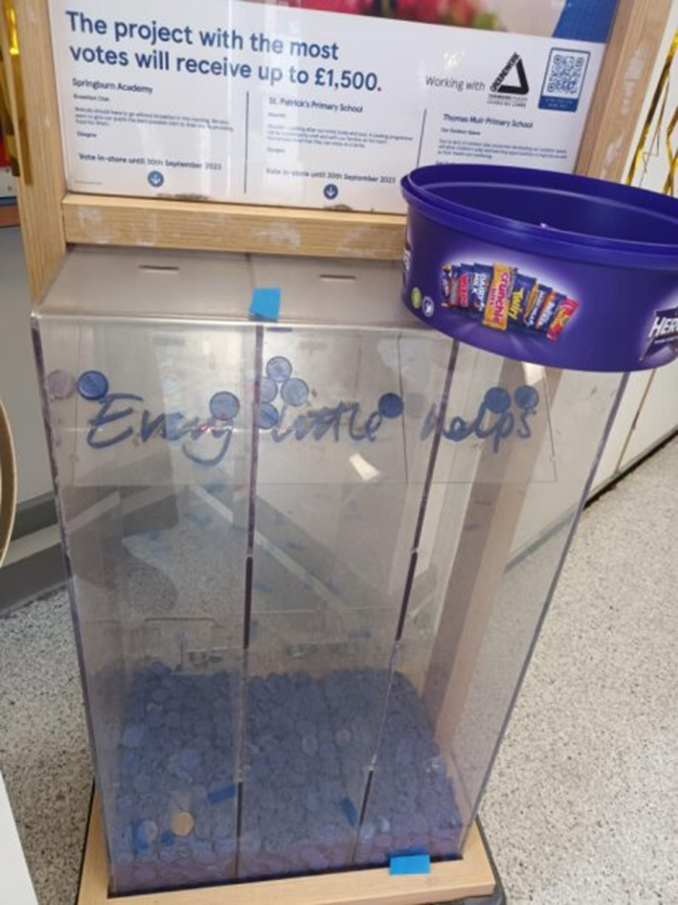
Voting In Stores
Closing dates for consideration to the next customer vote will be at least 6 weeks prior to vote starting
Awards are received within 2 month of the vote end
First place receives £1500 (…or what you applied for)
Second place receives up to £1000
Third place receives £500
Notes:
After the shortlist panel selections, successful applicants are asked to confirm they still want to go into the store vote, sometimes only 2 weeks before the vote starts.
Every shortlisted project in the customer vote is guaranteed at least £500 funding.
First and second place will only receive the full amount if they have applied for either, first place £1,500 or, second place £1,000
Encourage applicants to apply for full £1500 – they have a year to spend it.
The 3 month voting period in store is also a great opportunity to promote local projects and organisation to a wide audience.
This is a picture from a group in Bathgate’s social media encouraging shoppers to vote for them
After the results are out, celebrating with the awardees is a great opportunity for some comms activity
NOTE – get in touch with Tesco directly for any instore logistical support e.g. more tokens, POS queries, posters etc. we can send you this email if you get in touch

Slide 5


Who can help – our contact details on our website https://www.greenspacescotland.org.uk/fund-your-project
Contact the friendly greenspace scotland Community Enabler for your local area:
Shetland Island; Orkney Islands; Aberdeen; Aberdeenshire; Angus; Dundee; Perth & Kinross and Stirlingshire
rita.callander@greenspacescotland.org.uk 07825 678321
Highlands; Eilean Siar; Moray; Argyll & Bute; West Dunbartonshire; Inverclyde; Renfrewshire; Glasgow; Edinburgh; West Lothian; Mid Lothian and East Lothian
tamara.hedderwick@greenspacescotland.org.uk 07825 671968
East Dunbartonshire; Clackmannanshire; Falkirk; North Lanarkshire; South Lanarkshire; East Ayrshire; North Ayrshire; South Ayrshire; Scottish Borders and Dumfries & Galloway
sue.wyllie@greenspacescotland.org.uk 07825 678249
@TescoGrantsScotland @greenspacescot
Notes:
If you haven’t been in touch with your regional Enabler please get in touch, this slide shows our contact details on our website: https://www.greenspacescotland.org.uk/grant-funding – please also direct your community contacts to this page and our Twitter and Facebook social media channels
In summary –
We are here to help you get applications for your store, and providing info for instore promotion:-
Contact Enablers – to help groups with applications – your nominated groups will automatically hear from us
Contact Enablers – to find out results of a voting round if you can’t access this info on Tesco Comms or Yammer
Contact Enablers – to get contact details of awardees for promotions
Contact Enablers – to find out how many applications there are to your region, and what type ie. how many applications to each theme and if we need to encourage more applications.

Slide 6
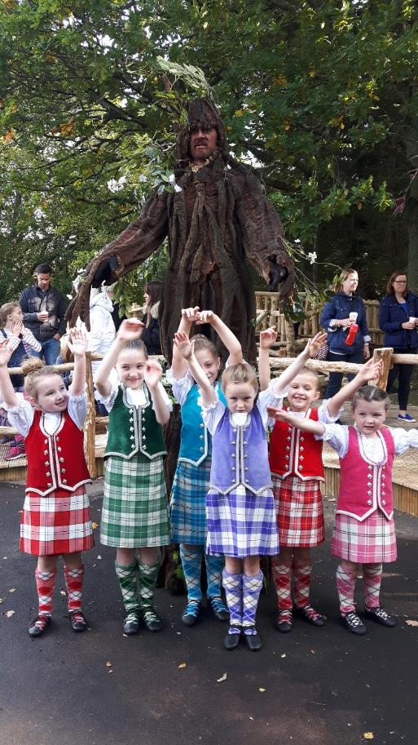
Examples of projects across Scotland that receive funding include:
Holiday clubs
Play areas,
Food banks
Counselling and support services for children
Equipment or non-statutory services for nurseries or schools e.g. forest schools, library books
Equipment for Girlguiding or Scouting Groups e.g. camping equipment, badges
Services or equipment to support children and young people’s health
Equipment and kit for youth sports teams
Setting up a Forest School or sensory garden or nature area
Notes:
Here are some examples of projects that are eligible for funding.
This can include capital spend such as equipment for village/community halls, for Brownie, Guide or Scout Groups e.g. camping equipment, badges and Equipment or non-statutory services for nurseries or schools e.g. forest schools, library books
Sessional costs are also eligible such as leaders to support mental health and wellbeing programmes; counselling and support services; services to support health issues such as cancer or dementia
Note - an organisation’s core costs are not eligible eg. ongoing office costs, heat and light, insurance etc.
Staff can nominate projects of ANY community benefit – although THEY MUST STILL APPLY through the normal process

Slide 7
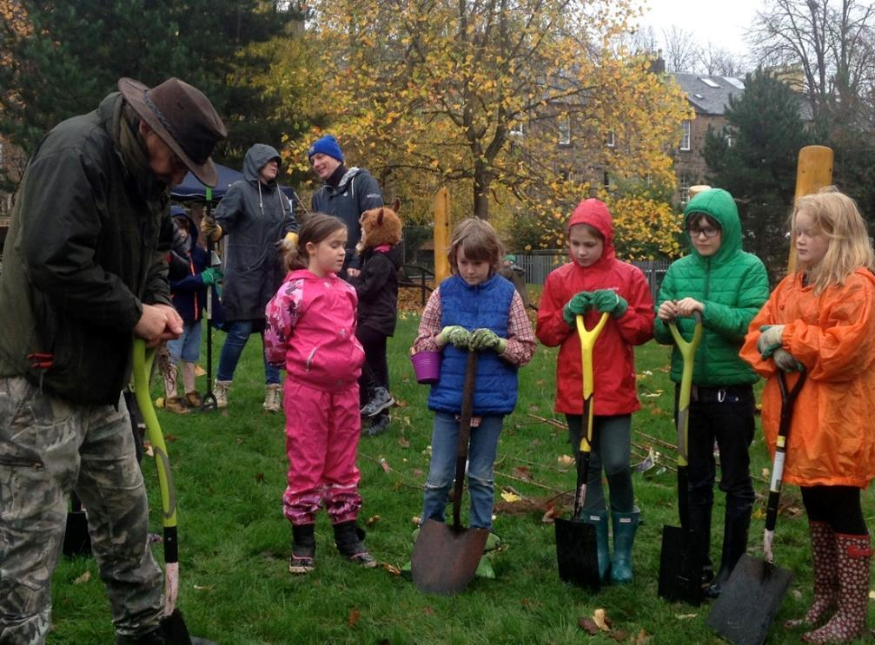
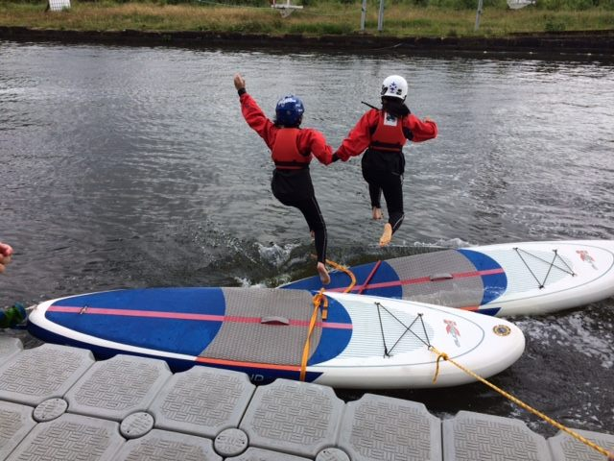
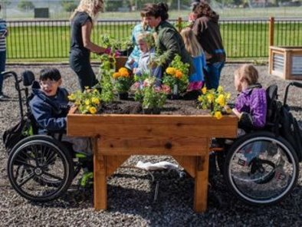
What can you apply for?
Groups can apply for a range of costs up to £1,500 such as:
Camping Outdoor equipment Weatherproof clothing |  | Sports Crafting Healthy snacks |  | Events Volunteer training Trips within the UK
Notes:
Tesco HQ would like to see each of the 3 themes represented in every 3 month customer voting period, one of the themed activities in each of the customer voting booths
Generally we are looking for Food Security applications as their no.s are usually low or non existent - sometimes there is a lack of CYPF applications – contact us for current app no.s in your award regions
All 87 regions have very different application no.s to each theme.
Sometimes you will see a national organisation in your customer voting - this may be because there is a lack of local groups applying
We are keen to make TCG accessible to your local groups

Slide 8
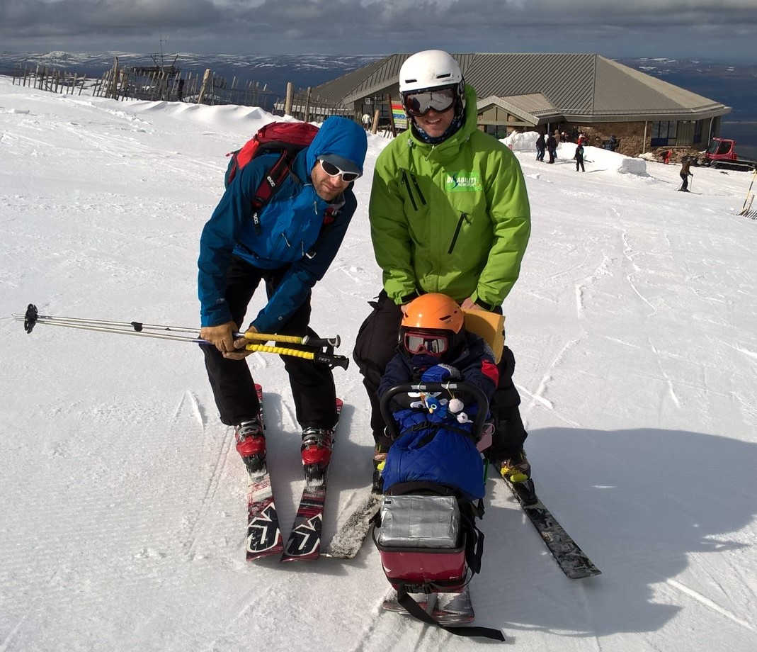

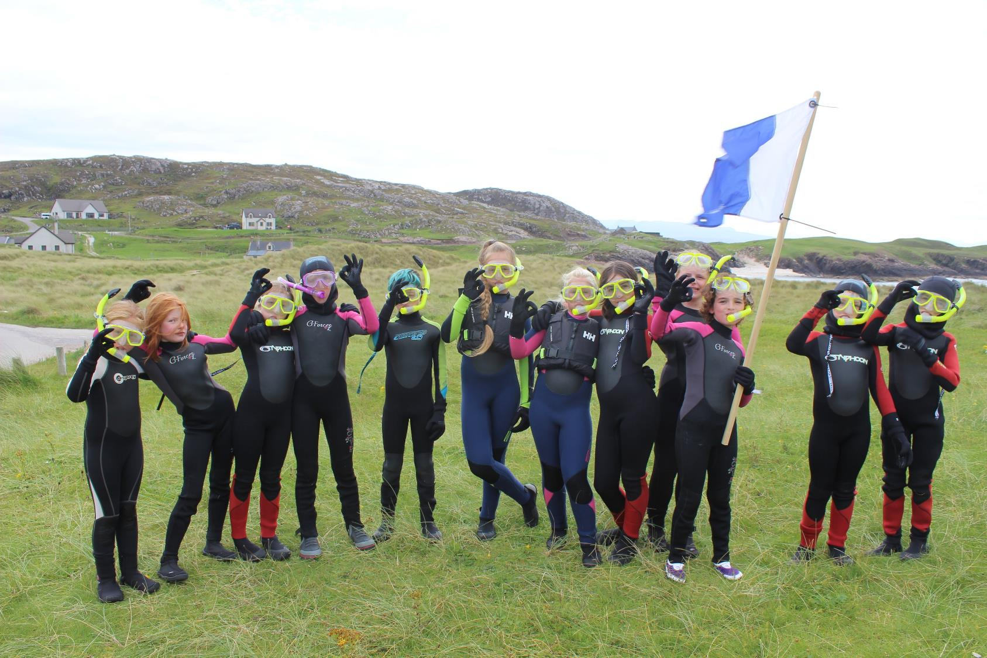
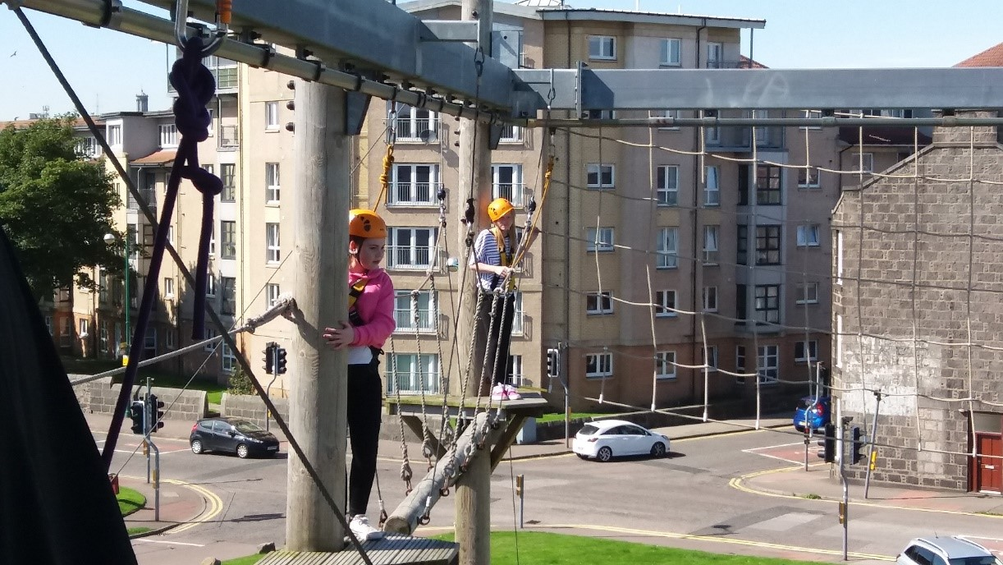
Previously awarded outdoor activities:

Slide 9
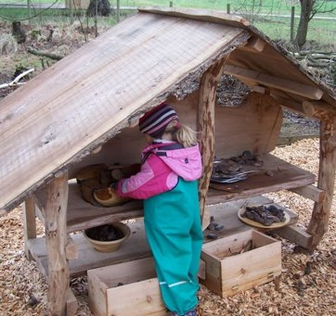
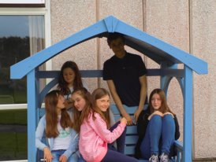
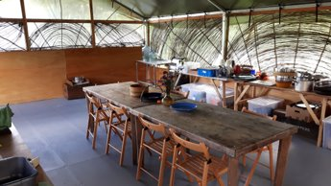
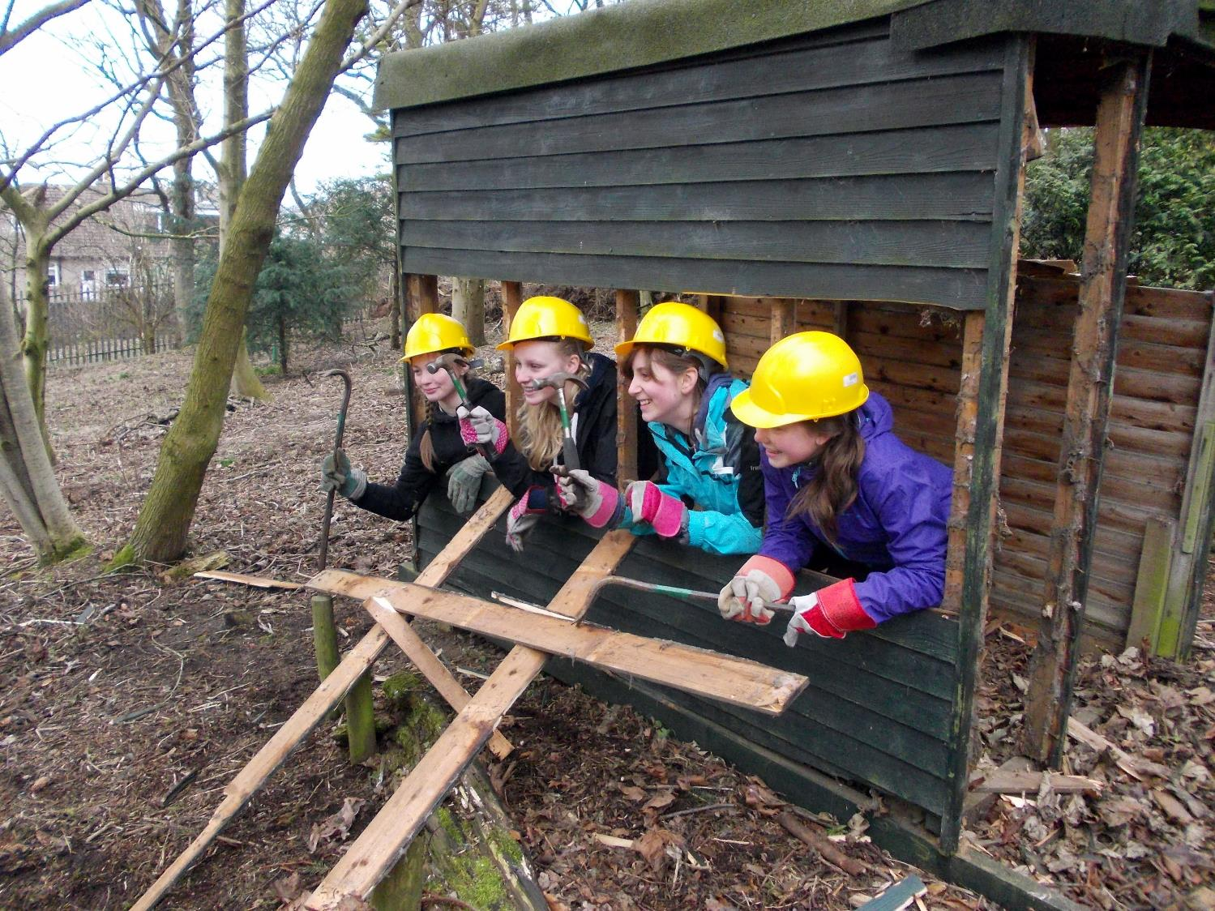
Previously awarded building:

Slide 10
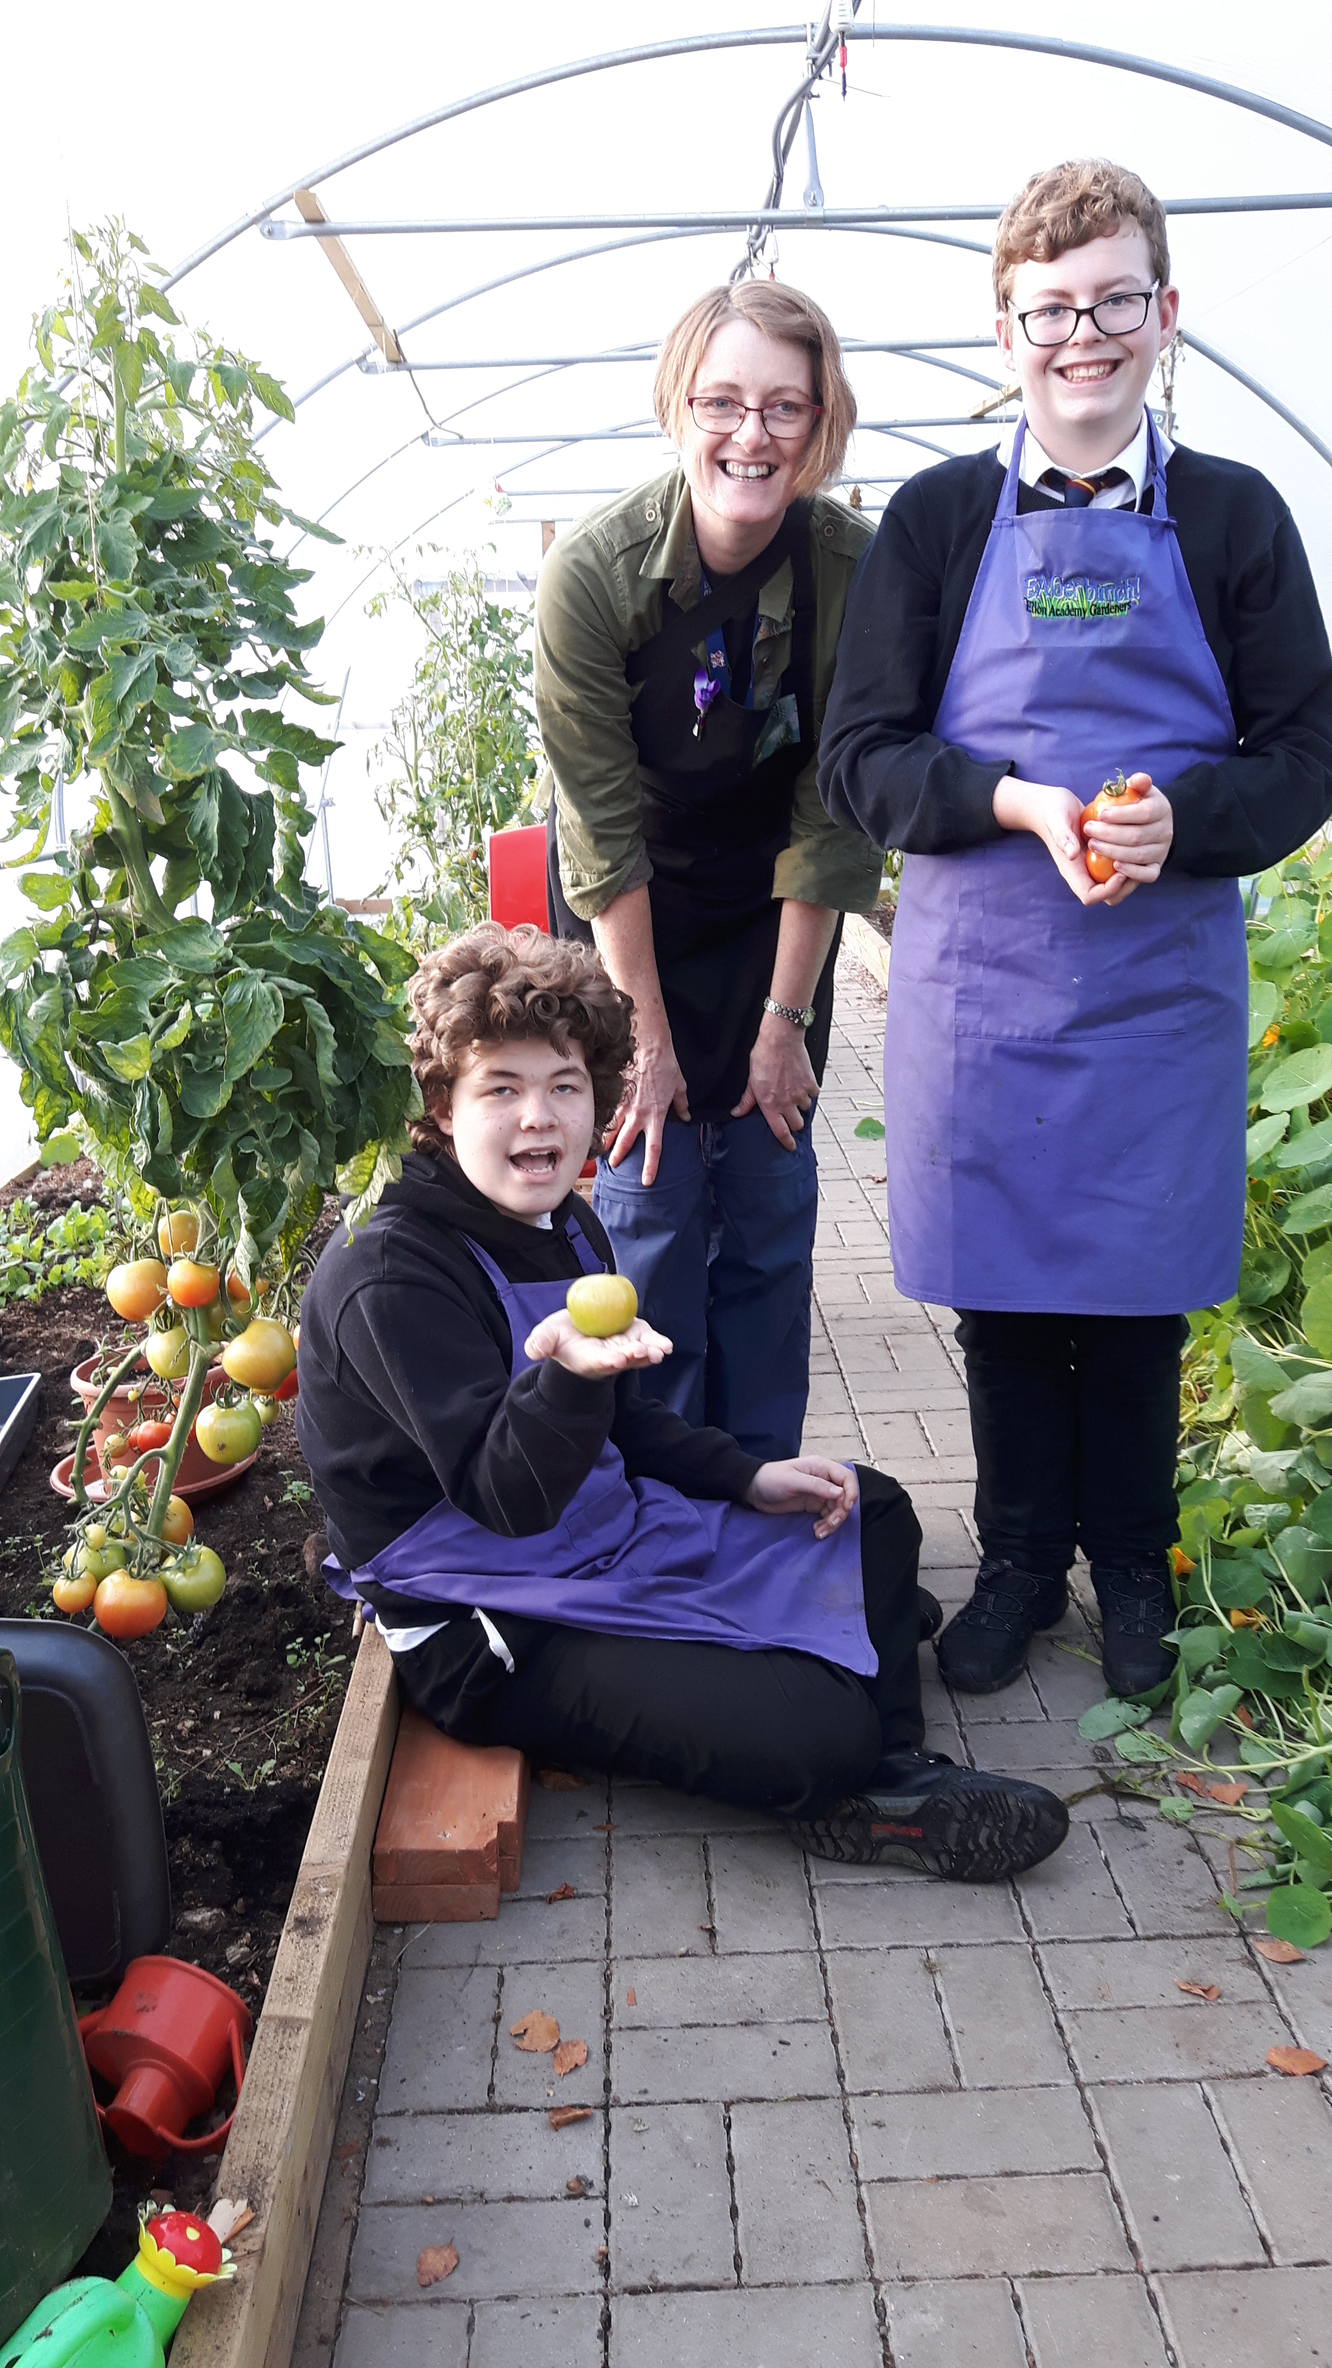
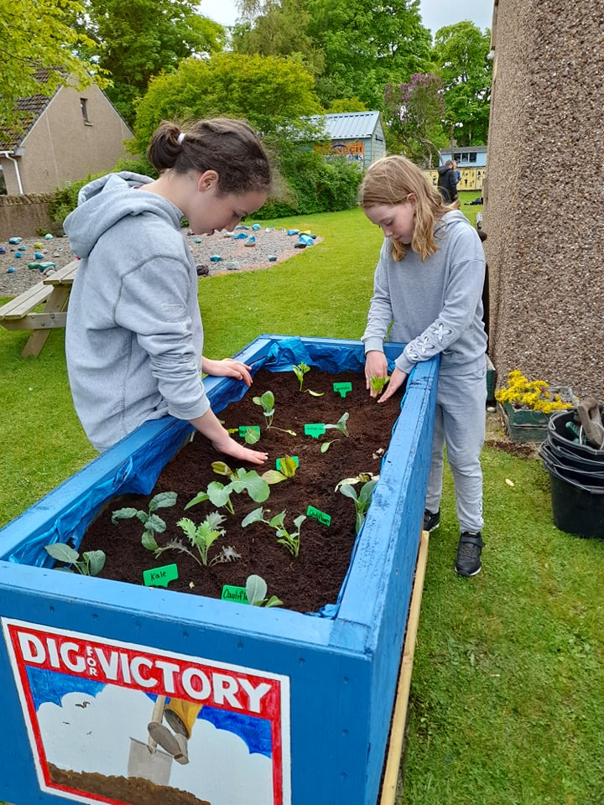
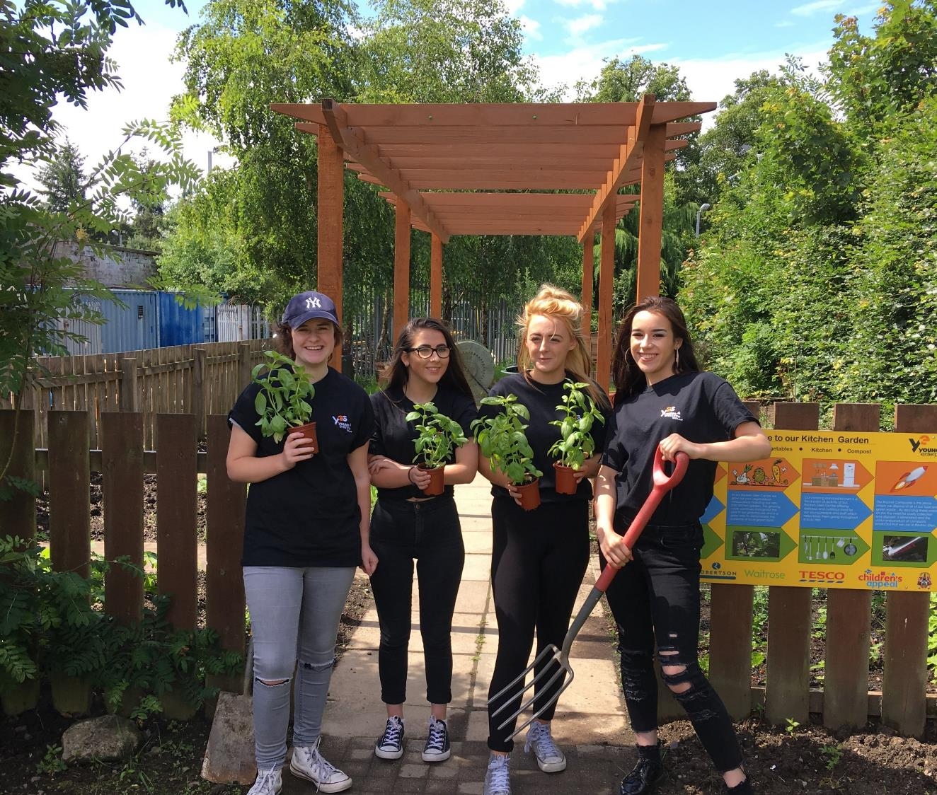
Previously awarded food growing:

Slide 11
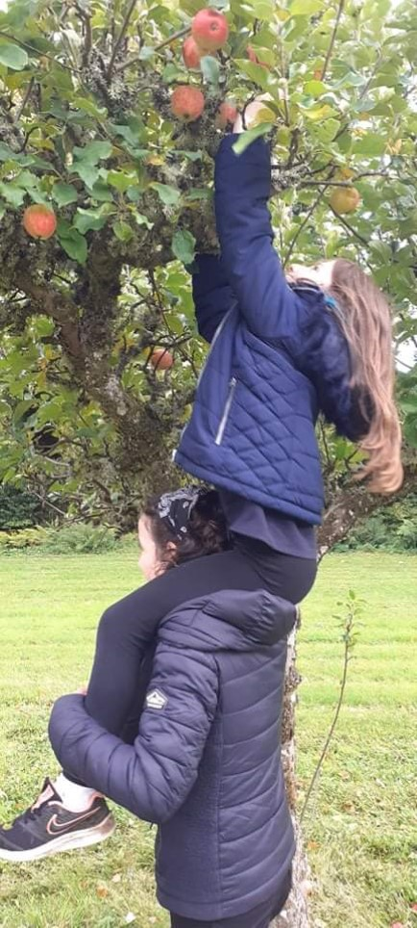
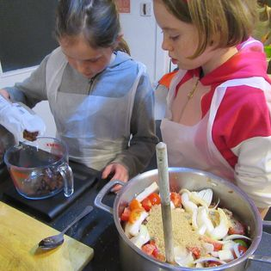
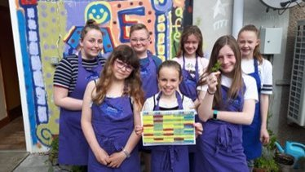
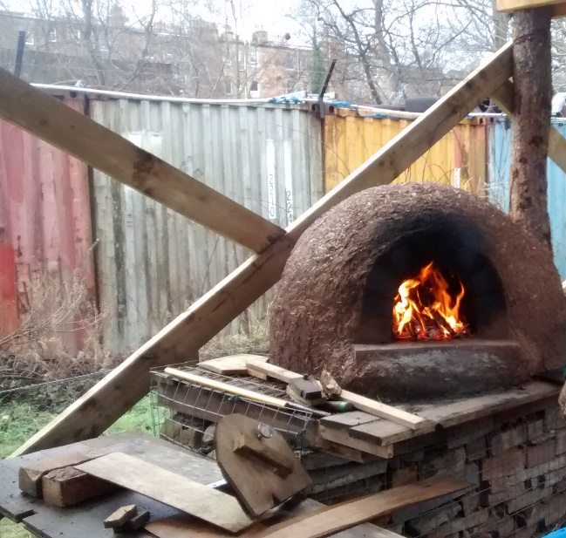
Previously awarded cooking:

Slide 12
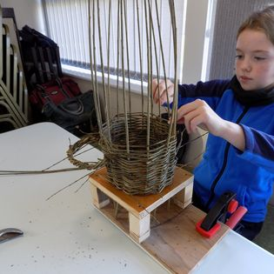
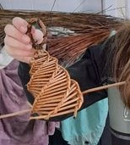
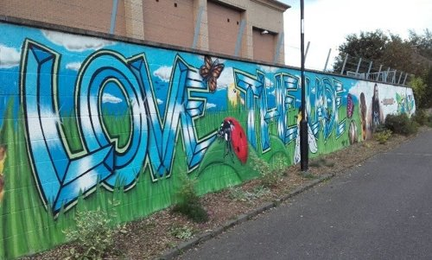
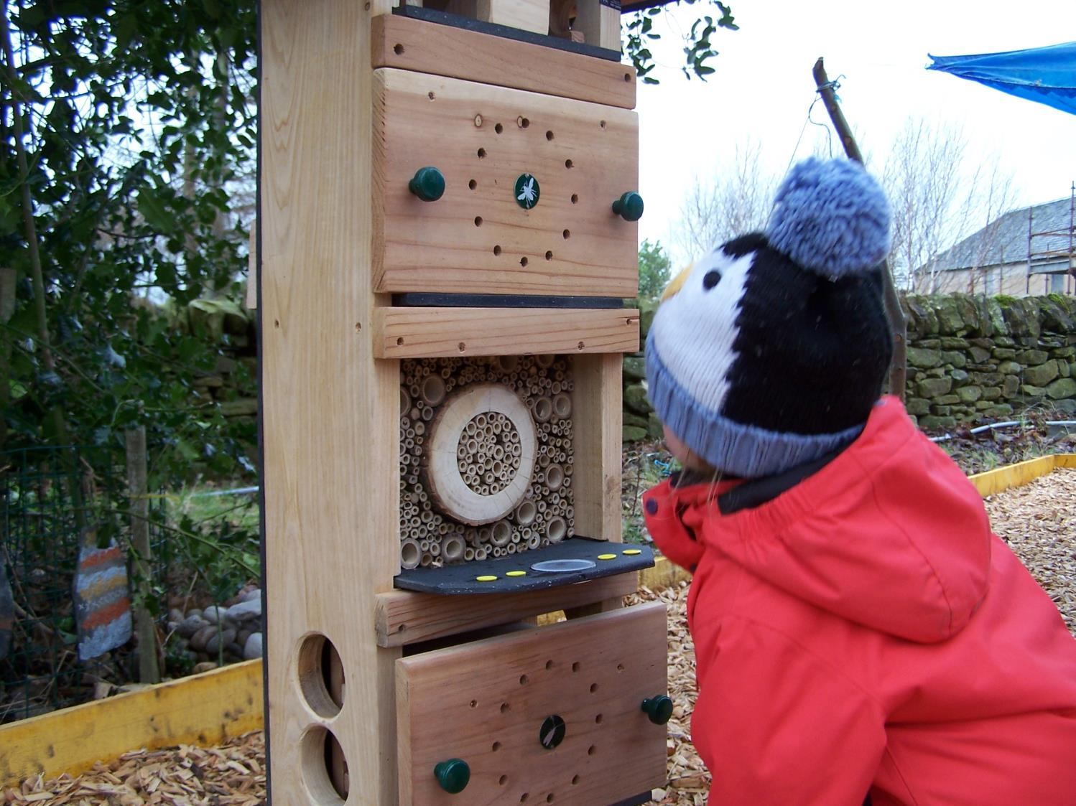
Previously awarded arts and crafts:

Slide 13
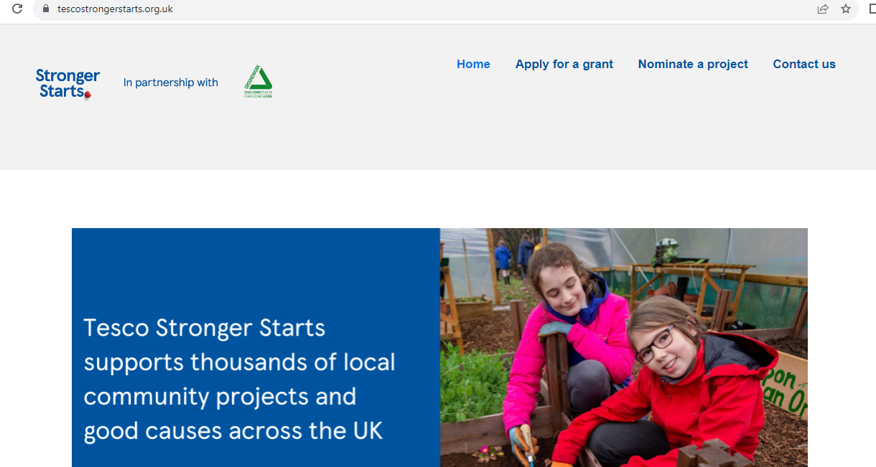

How do groups apply?
Online – www.tescostrongerstarts.org.uk
Notes:
So how does the application system work? Here is a screenshot of the current webpage with both the Apply for a Grant and the Nominate a Project tabs.
The process is a bit like Marmite some people love it and others hate it. It’s an online application through a dedicated website.
The important thing to remember is that our team can support applicants through this process and we are here to help.
Link to drop in the chat
https://tescocommunitygrants.org.uk/

Slide 14
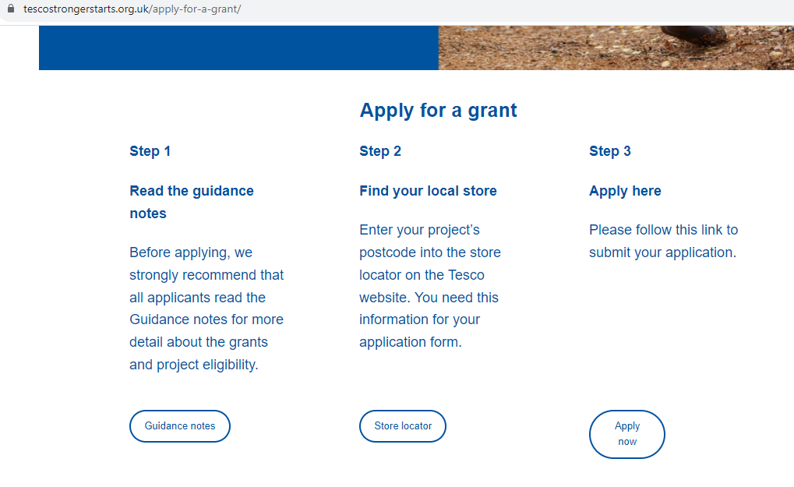

Slide 15
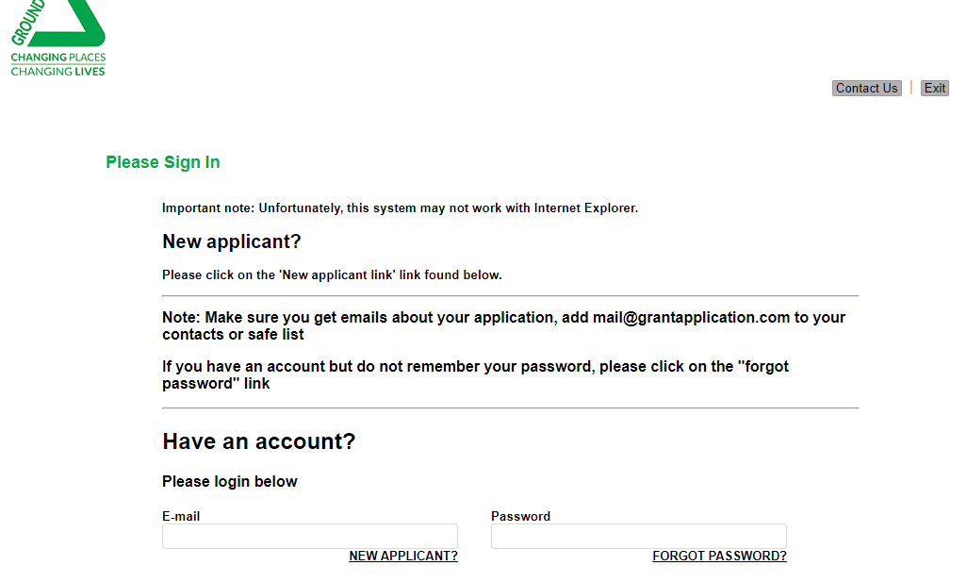

Slide 16
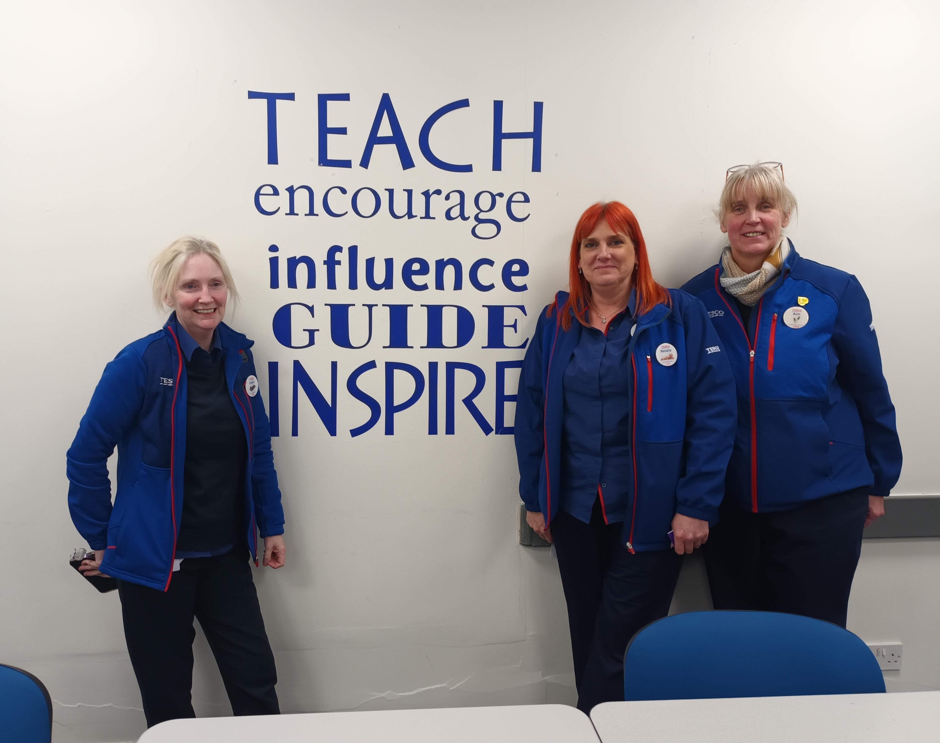
Local Tesco Community Champions and colleagues make up the local shortlisting panels to select which 3 groups go into each customer vote.
Please do tell them in the application what a difference the funding would make.

