Slide 1
Strategic Plan
Today, Tomorrow, Together
2023 to 2028

Slide 2
Introduction
Girlguiding exists to help girls find their voice and build skills and confidence - inspiring them to discover the best in themselves and empower them to make a positive difference in their community.
In Scotland, between school, social media, friendships and relationships – there’s a lot going on for girls today. Not to mention the future, the planet, education and what jobs might be around in few years’ time. That’s why Girlguiding is more important than ever.

Slide 3
Who we are
Vision
An equal world where all girls can make a positive difference, be happy, safe and fulfil their potential
Mission
Through fun, friendship, challenge and adventure we empower girls to find their voice, inspiring them to discover the best in themselves and to make a positive difference in their community
Values
We are caring, challenging, empowering, fun, inclusive and inspiring.

Slide 4
Who we are
We’re 40,000 girls from 4 to 18 who come together to laugh, learn, explore and have adventures. We’re 9,000 volunteers who make guiding happen by giving our time, talents, enthusiasm and care for girls.
We’re 3,000 local groups having fun and exploring activities week in, week out all over Scotland.
We’re her first night away, weekend camping adventures, summer music festivals, emails to her MSP about the things she cares about.
We’re the badges she collects to capture the journey she’s chosen – anything from mindfulness to rock-climbing to crafting to coding.
We’re a powerful collective voice – by girls, for girls – changing the world for the better.

Slide 5
Ages 4-7
Ages 7-10
Ages 10-14
Ages 14-18
Notes:
Rainbows welcomes all girls from 4 to 7 years old coming together to play, learn and have tons of fun in a colourful, safe space. She’ll laugh, sing and make a happy mess (and help clear it up!) as she chooses her way through our programme of activities. She’ll have plenty of magic moments: she might become a time traveller, an animal tracker, a pop singer, a stargazer. It’s a wonderful world of adventure, week after week, just for her.
Brownies welcomes all girls from 7 to 10 years old having nonstop fun, learning and adventure. It’s full of firsts: she might grow her first plant, cook her first cake, put up (and take down) her first tent, light her first fire, go on her first fun-packed weekend away with guiding friends. With a helpful hand from our encouraging volunteers, she’ll explore her creative side, get out into the great outdoors, and start learning to look after herself, others and the world we live in. There’s something for every girl at Brownies, and plenty of moments she’ll
never forget.
Guides is a relaxed, welcoming space where you can have fun, learn and be yourself with good friends from 10 to 14 years old. A place where you can explore the things you love and do stuff you’ve never done before. Where else can you think up a new sport, make a new perfume, cook over a campfire, design
an advertising campaign, have a mocktail party, raise money for a charity you believe in? At Guides, you can do all of this and loads more.
Rangers is your space – where you get together with other girls from 14 to 18 to have fun, learn more, give back, hang out, and just be you. It’s regular meetings with your local group, trips at home and abroad, making a difference to the things you care about. It’s an open and relaxed space to talk with good friends – it’s qualifications and badges and awards. It’s the freedom to be more independent, and to do what makes you happy. Rangers is what you make of it.

Slide 6
What we do
We believe in the value of learning by doing and five interlinking principles - the Five Essentials - put this into practice. They apply to all young members - Rainbows, Brownies, Guides and Rangers - as well as adult volunteers.
The Girlguiding programme is the suite of core resources, activities and badges on offer centrally which girls and leaders use to plan activities in and out of the unit meeting space. All programme resources have been designed to benefit the girl and enhance her guiding experience. Each girl’s experience of the programme is unique. It is shaped by her, her peer group and her unit leadership team.
Notes:
The Girlguiding programme is the suite of core resources, activities and badges on offer centrally which girls and leaders use to plan activities in and out of the unit meeting space. All programme resources have been designed to benefit the girl and enhance her guiding experience. They have been designed to challenge, inspire and empower our girls and young women. Each girl’s experience of the programme is unique. It is shaped by her, her peer group and her unit leadership team. By understanding the girls we’re working with, we’re able to help them get the most out of guiding.

Slide 7
The difference we make
The Five Essentials help us to deliver the objectives for the six development areas in our Educational Framework:
Spiritual development - girls develop their spiritual identity while understanding and respecting the spiritual choices of others.
Social development - girls learn to take responsibility for themselves and others, become reliable team members and confident leaders.
Emotional development - through fun and friendship, girls develop their self-esteem and gain self-confidence, building respect for themselves and each other.
Physical development - girls develop their mental, physical and emotional well-being through a range of active experiences.
Moral development - girls develop their understanding of what is right and wrong, and develop their sense of conduct.
Intellectual development - through the activities and challenges they experience, girls become adept at processing information, making decisions and self-reflection.

Slide 8
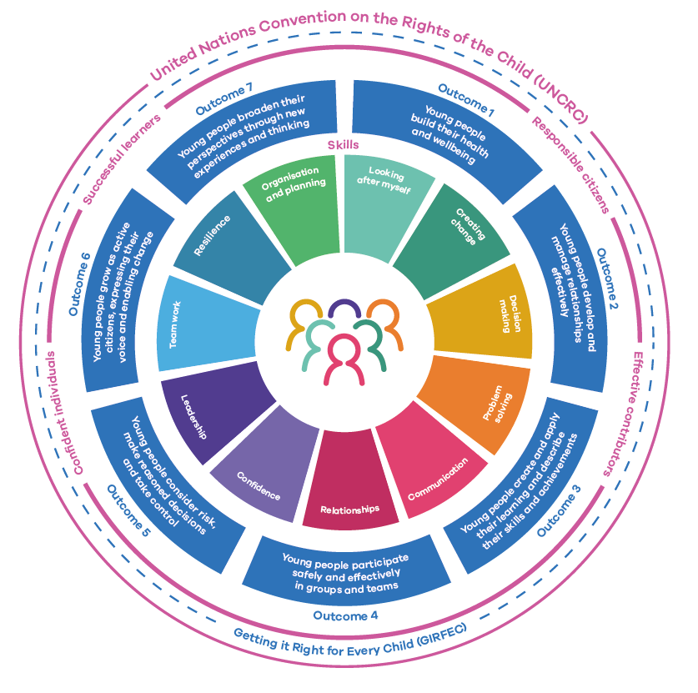
The difference we make
Through our Five Essentials and our integration of the ambitions within Getting It Right for Every Child (GIRFEC), United Nationals Convention on the Rights of the Child (UNCRC) and National Youth Work Outcomes and Skills Framework, we impart non-formal education to girls and young women aged 4 to 18.
Girlguiding also empowers women to develop their potential long after they reach the age of 18. Women use the skills they have gained from guiding in everyday life, and many stay with guiding and take on a leadership role – thus continuing the cycle of skills development.

Slide 9
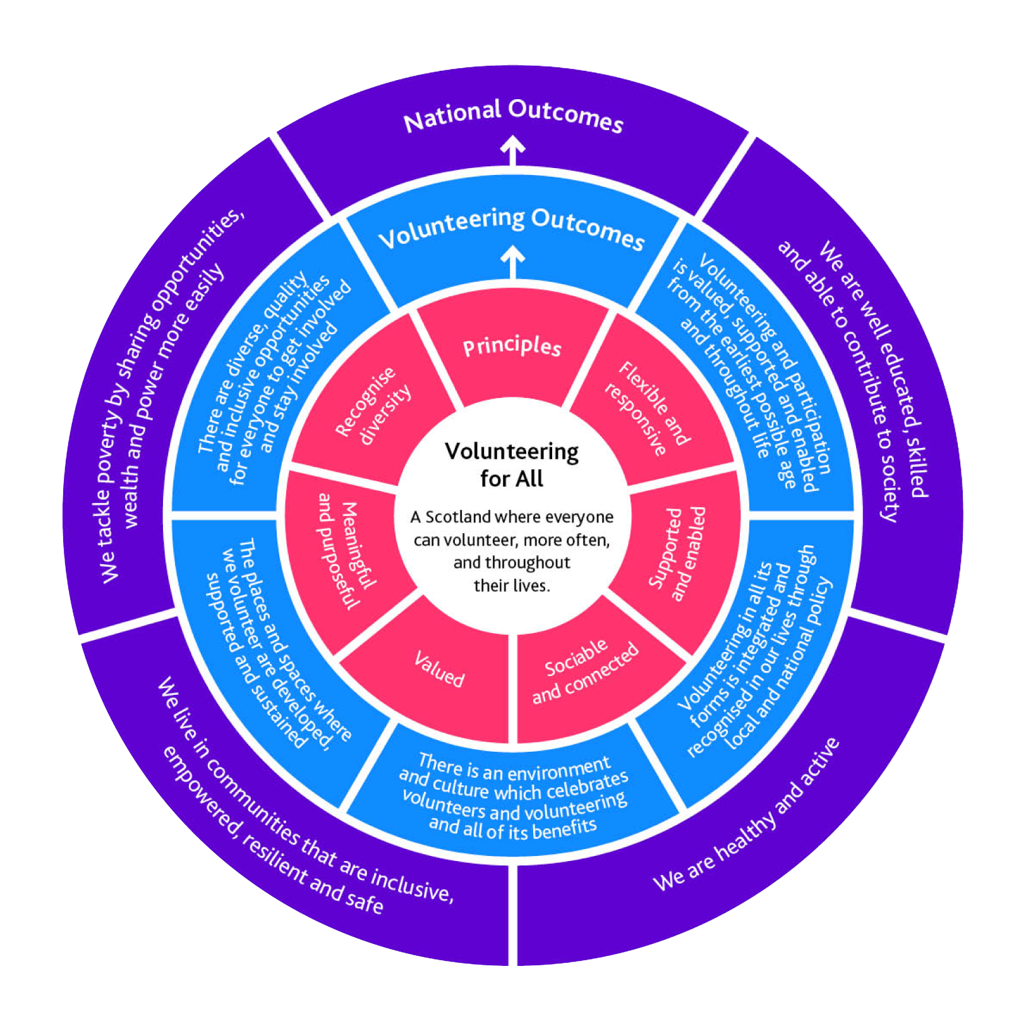
The difference we make
The value of volunteering is documented within Volunteering for All: The National Framework. At Girlguiding Scotland we see how volunteering makes a difference to our young members, to our volunteers and to communities across Scotland, every single day.
From our Rainbow and Brownie helpers (aged 10-14), Peer Educators (aged 14 to 25) and our young leaders (aged 14 -17) to those that volunteer for Duke of Edinburgh with us, we help young people begin their volunteering journey. We also provide a huge range of opportunities for adults. From youth work to administration and finance to PR and people management, our volunteers develop skills, make friends and have fun.

Slide 10
We help all girls know they can do anything. We’re Girlguiding Scotland.
Vision
Values

Slide 11
Our Strategic priorities 2023-2028

Slide 12
Today, tomorrow, together
Shared goals for Girlguiding & Girlguiding Scotland since 2020
Sustainable and efficient
We want to offer experiences so fun, accessible and empowering that they inspire more girls and volunteers to join than ever before.
.
We want volunteering to be flexible so it’s easier for people to give their time. So, we’re going to create opportunities that fit around people’s lives.
We want Girlguiding to have an even bigger impact and influence on local communities and across the UK.
The best way to do brilliant things, is by getting the basics right. We’re going to build strong foundations, including: strong structures and processes; empowering girls to lead the way and; new ways of working.

Slide 13
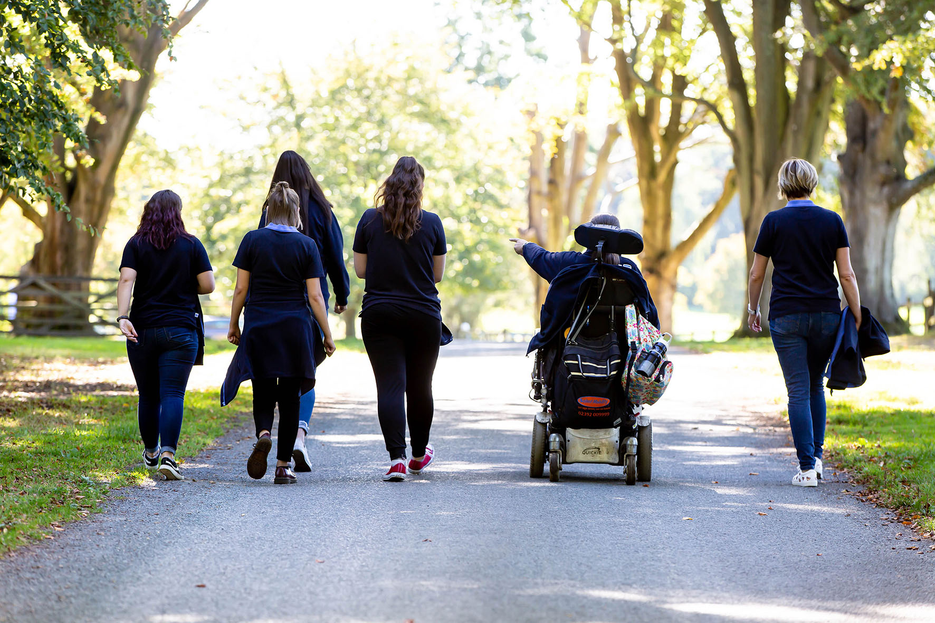
Today, tomorrow, together
A shift in focus for Girlguiding Scotland in 2023+
Since 2020, Girlguiding Scotland has shared Girlguiding’s commitment to the goals set out in Today, tomorrow, together.
In March 2023, after reviewing our strategic priorities alongside emerging external threats and opportunities, our trustees and members of the operational board clearly identified that an increased focus on volunteer recruitment and retention is essential to achieving our mission.
Over the next 5 years, 4 dedicated programmes of work will recognise the vital role that our volunteers play in delivering the mission and goals we share with Girlguiding.

Slide 14
We share Girlguiding’s goals for today, tomorrow, together. To achieve these goals for girls in Scotland, we’ll focus on our volunteers and the volunteering experience over the next 5 years. We’ll innovate and inspire to make volunteering with Girlguiding Scotland more desirable, more welcoming and even more rewarding. We hope you’ll join us!

Slide 15
How we got here
Our strategic focus for the next 5 years reflects insights gathered from girls and volunteers at every level of guiding, from every part of Scotland. Girls and adults have told us they want to be part of an inspiring organisation that reflects our values and offers fun, friendship and amazing opportunities in a unique girl-only space.
We also know that guiding doesn’t happen in a vacuum. With the help of North Star Consultancy, we surveyed the external challenges that are likely to impact our ability to achieve our goals now and in the future.
To deliver our vision and mission for all girls (including the many thousands already waiting to join) we need to simplify our systems and processes and offer more flexibility to make volunteering easier and more rewarding.
With this plan, we’re committed to making the changes needed to make this happen in the next 5 years.

Slide 16
Girlguiding Scotland’s priorities, 2023 - 2028
Recognising the vital role of volunteers in delivering our mission
Enquire
Welcome
Stay
Develop
We'll increase our visibility through a range of local and national recruitment and awareness raising activities so more people from a range of backgrounds enquire about volunteering with Girlguiding Scotland.
We’ll support local areas to improve the consistency and quality of the welcome new volunteers receive, making it quicker and easier to join Girlguiding Scotland as an adult. We’ll also champion flexible approaches to guiding to ensure our offer meets the needs of today’s volunteers as well as today’s girls.
We’ll deliver unique, high quality girl events that encourage more volunteers to have fun, build friendships and see the difference they make to the lives of girls across Scotland. We’ll also celebrate our volunteers’ achievements, encouraging them to stay in guiding.
We’ll give all members access to leadership opportunities and training, so they develop new skills and gain confidence. Our existing volunteers will develop in their roles and more of our young members will progress to adult volunteering, helping to build our future volunteer workforce.
The essentials
We’ll ensure we’re efficient, compliant and well-run. We’ll lead by example and support our counties, districts/ divisions and units to follow charity best practice and meet their responsibilities with regards to Girlguiding policies and procedures, and the law.

Slide 17
How will we measure success?
Performance indicators
 | Measure
Enquire | New volunteer enquiries
Welcome | Volunteer joiners
Welcome | Volunteer average length of time to join
Welcome | % new vol enquirers waiting 7+ days for contact
Welcome | % new parent enquirers waiting 21+ days for contact
Welcome | % Volunteers completed ‘including all’ training
Stay | Volunteer Leavers
Stay | % Volunteers retained since February
 | Measure
Stay | Internal awards nominations
Stay | External award nominations
Develop | Girls moving to volunteer roles
Develop | Young leader qualifications earned
Develop | Adults completing the leader development programme
Develop | Adults completing Going Away With qualification
Develop | Courses completed on the learning & development platform

